Slide 1

PlanAlyzer
Assessing Threats to the Validity
of Online Field Experiments
Emma Tosch, Eytan Bakshy,
Emery Berger, David Jensen, Eliot Moss
SPLASH - OOPSLA
23 October 2019
Notes:
Thank you, Jan. This is work with Eytan Bakshy of Facebook, and some folks at Umass – Emery and Eliot, whom many of you know, and David Jensen.

Slide 2
What this talk is about
Overview of what online experiments are
Introduce the most popular DSL for experimentation (PlanOut)
Threats to validity unique to programmatically defined experiments
Our tool, PlanAlyer:
Checks for these threats to validity
Generates data required for statistical analyses
Evaluate on a corpus of real experiments

Slide 3
What are online field experiments?
Notes:
So the first thing you might be asking about this talk, if you are unfamiliar with the domain, is: what are online field experiments?

Slide 4

Suppose you run a website…
Suppose it’s written in JS
Suppose two existing vars:
message
log_obj
Suppose we record #/clicks
Notes:
Suppose you run a website. <CLICK> For example, the New York Times. You’d like to see if you can’t increase some subscription metric by testing out different messages <CLICK> on your subscription button. Suppose your website is written in Javacript, and suppose <CLICK> that there are two variables you want to bind to: <CLICK> message, which refers to the text of the subscription button, and <CLICK> an object that tracks data you want to store for later analysis. Also suppose that <CLICK> somewhere else in the code, you are recording clicks.

Slide 5
Suppose you run a website…
msgA = “Give the Times”;
msgB = “Play the Crossword”;
if(Math.random() < 0.001) {// Select a small number of participants.
if (Math.random() > 0.5) {// Split across messages.
message = msgA;
} else {
message = msgB;
}
}
log_obj[”button_message"]= message; // Track which message was used.
Notes:
You implement this test in Javascript like so: <CLICK> you flip a coin every time during each visit, and some small percentage of the time, <CLICK> you randomly assign the visitor to one of two messages. <CLICK> Then you store which message was used. Some of you may recognize this simple experiment as

Slide 6
Suppose you run a website…
A/B Test
msgA = “Give the Times”;
msgB = “Play the Crossword”;
if(Math.random() < 0.001) {// Select a small number of participants.
if (Math.random() > 0.5) {// Split across messages.
message = msgA;
} else {
message = msgB;
}
}
log_obj[”button_message"]= message; // Track which message was used.
Suppose it’s written in JS
Suppose two existing vars:
message
log_obj
Suppose we record #/clicks
Notes:
an A/B test.

Slide 7
Congratulations! An A/B test on the web is a simple online experiment!

Slide 8
Now that you’ve written a online field experiment…
What do you do with it?
Notes:
So, now that you’ve written an online field experiment <CLICK>, what do you do with it?

Slide 9
Analyze the results, or:
Does my treatment have an effect?
Notes:
Well, you want to analyze the results in service of the question <CLICK> does my treatment, which here is the message text, have an effect on the the outcome of interest, which we've alluded to being a function of clicks?

Slide 10

Possible Intended Analysis
Treatments
$\frac{\#/ppl clicked msgA }{\#/ppl saw msgA}$ - $\frac{\#/ppl clicked msgB}{\#/ppl saw msgB}$
Average Treatment Effect (ATE)
msgA = "Give the Times";
msgB = "Play the Crossword";
if(Math.random() < 0.001) {// Select a small number of participants.
if (Math.random() > 0.5) {// Split across messages.
message = msgA;
} else {
message = msgB;
}
}
log_obj["button_message"]= message; // Track which message was used.
Avg(Y | message=msgA) – Avg(Y | message=msgB)
Contrasts : Treatments that can be compared using ATE
Notes:
So, let's consider a possible outcome of interest, and the associated procedure for estimating it. <CLICK> We want to know whether there was a difference in the click rate between people who saw message A versus message B. This is an instance of a well-known estimator of causal effect, known as the <CLICK> average treatment effect, or ATE. <CLICK> In this case, the two treatments we consider are the A and B variants of the message. This is often written in a way that abstracts over the outcome variable, <CLICK> just referring to it as Y. Statisticians will often use this notation, which we’ll see again later in the talk. The important part is that ATE can only be applied to certain pairs of treatments, <CLICK> which are referred to as contrasts.

Slide 11
Possible Intended Analysis
Treatments
$\frac{\#/ppl clicked msgA }{\#/ppl saw msgA}$ - $\frac{\#/ppl clicked msgB}{\#/ppl saw msgB}$
Average Treatment Effect (ATE)
Danger
msgA = "Give the Times";
msgB = "Play the Crossword";
if(Math.random() < 0.001) {// Select a small number of participants.
if (Math.random() > 0.5) {// Split across messages.
message = msgA;
} else {
message = msgB;
}
}
log_obj["button_message"]= message; // Track which message was used.
Avg(Y | message=msgA) – Avg(Y | message=msgB)
Contrasts : Treatments that can be compared using ATE
Notes:
However, there is a problem.

Slide 12
Possible Intended Analysis
$\frac{\#/ppl clicked msgA }{\#/ppl saw msgA}$ - $\frac{\#/ppl clicked msgB}{\#/ppl saw msgB}$
msgA = "Give the Times";
msgB = "Play the Crossword";
if(Math.random() < 0.001) {// Select a small number of participants.
if (Math.random() > 0.5) {// Split across messages.
message = msgA;
} else {
message = msgB;
}
}
log_obj["button_message"]= message; // Track which message was used.
Notes:
Our outcome of interest is in terms of people who clicked the button, but <CLICK> our code isn’t tracking people.

Slide 13

Problemz!
Notes:
We don’t know how many individuals have clicked on that button; in the worst case our data could be coming from the same person, and in the best case we have one data point per person.

Slide 14
No worries; use a DSL!
Notes:
Okay, so this actually isn’t a problem because there are DSLs out there for experimentation.

Slide 15
PlanOut Framework + DSL (by Facebook)
msgA = "Give the Times";
msgB = "Play the Crossword";
if(Math.random() < 0.001) {
if (Math.random() > 0.5) {
message = msgA;
} else {
message = msgB;
}
}
log_obj["button_message"]= message;
msgA = "Give the Times";
msgB = "Play the Crossword";
if (Math.random() > 0.5) {
message = msgA;
} else {
message = msgB;
}
log_obj["button_message"]= message;
Framework Manages:
Sampling
Notes:
A popular choice is Facebook’s PlanOut. <CLICK> The framework that backs PlanOut manages <CLICK> sampling, which we were previously doing with the outer coin flip, but don’t need now <CLICK>. <PAUSE>

Slide 16
PlanOut Framework + DSL (by Facebook)
msgA = "Give the Times";
msgB = "Play the Crossword";
if (Math.random() > 0.5) {
message = msgA;
} else {
message = msgB;
}
log_obj["button_message"]= message;
msgA = "Give the Times";
msgB = "Play the Crossword";
if (Math.random() > 0.5) {
message = msgA;
} else {
message = msgB;
}
log_obj["button_message"]= message;
msgA = "Give the Times";
msgB = "Play the Crossword";
if (Math.random() > 0.5) {
message = msgA;
} else {
message = msgB;
}
Framework Manages:
Sampling
Concurrent Exps.
Data recording
Notes:
PlanOut also manages <CLICK> concurrently running experiments, which is an important rationale for choosing PlanOut, but is tangential to our concerns.
More important to us is that PlanOut manages <CLICK> data recording, so we no longer need to track manually <CLICK> which message users received.

Slide 17
PlanOut Framework + DSL (by Facebook)
msgA = "Give the Times";
msgB = "Play the Crossword";
if (bernoulliTrial(p=0.5, salt="flip”, unit=userid)) {
message = msgA;
} else {
message = msgB;
}
msgA = "Give the Times";
msgB = "Play the Crossword";
if (Math.random() > 0.5) {
message = msgA;
} else {
message = msgB;
}
Framework Manages:
Sampling
Concurrent Exps.
Data recording
Framework Manages:
Sampling
Concurrent Exps.
Data recording
DSL specifies
which units (subjects/participants)
mapped to treatments
Notes:
And then we have the DSL itself <CLICK>, whose features we will get into in a moment, but for now know that it looks like Javascript <CLICK>, with named arguments, and its purpose is to map units to treatments. We also might want to update this script,

Slide 18
PlanOut Framework + DSL (by Facebook)
msgA = "Give the Times";
msgB = "Play the Crossword";
if (bernoulliTrial(p=0.5, salt="flip", unit=userid)) {
message = msgA;
} else {
message = msgB;
}
Framework Manages:
Sampling
Concurrent Exps.
Data recording
Framework Manages:
Sampling
Concurrent Exps.
Data recording
DSL specifies
which units (subjects/participants)
mapped to treatments
Must be able to iterate on design!
msgA = "Give the Times";
msgB = "Play the Crossword";
if(!canUpSell(userid=userid)){
return false;
}
message = uniformChoice(choices=[msgA, msgB], unit=userid);
Notes:
expressing this experiment more compactly, and while we’re at it, we decide to make it a little more targeted, <CLICK> by only running the experiment on paying customers, rather than, for example, those pesky graduate students like me who have a subscription through their university. The ability to iterate on design is critically important to experimentation, <CLICK> so this workflow encapsulates a representative use-case for PlanOut, where deployed versions of experiments can be quite a bit more complex than our running example. So critically,

Slide 19
Solution: PlanOut DSL (by Facebook)
msgA = "Give the Times";
msgB = "Play the Crossword";
if(bernoulliTrial(p=0.5, salt="flip”, unit=userid)) {
message = msgA;
} else {
message = msgB;
}
return true;
Mapping must be unbiased
to accurately estimate
average treatment effect
Framework Manages:
Sampling
Concurrent Exps.
Data recording
DSL specifies which
units (subjects/participants)
mapped to treatments
msgA = "Give the Times";
msgB = "Play the Crossword";
if(!canUpSell(userid=userid)){
return false;
}
message = uniformChoice(choices=[msgA, msgB], unit=userid);
Notes:
The mapping must be unbiased <CLICK>, in order to accurate estimate <CLICK> the average treatment effect, or ATE.

Slide 20
How does PlanOut express this mapping?
How do we know that the mapping is unbiased?
How do we know whether our analyses are consistent with that mapping?
Notes:
So, we will first introduce some of the domain specific features of PlanOut that aid in this mapping, and then we will address the heart of the issue: <CLICK> how we can know whether the mapping is unbiased? And <CLICK> How do we know whether our analyses are consistent with that mapping?

Slide 21
How PlanOut expresses mapping
msgA = "Give the Times";
msgB = "Play the Crossword";
if(bernoulliTrial(p=0.5, salt="flip”, unit=userid)) {
message = msgA;
} else {
message = msgB;
}
return true;
Framework Manages:
Sampling
Concurrent Exps.
Data recording
DSL specifies which
units (subjects/participants)
mapped to treatments
Built-in pseudo-random functions
msgA = "Give the Times";
msgB = "Play the Crossword";
if(!canUpSell(userid=userid)){
return false;
}
message = uniformChoice(choices=[msgA, msgB], unit=userid);
Notes:
So, PlanOut contains built-in pseudo-random functions that are seeded with some experiment-specific data, including

Slide 22
How PlanOut expresses mapping
msgA = "Give the Times";
msgB = "Play the Crossword";
if(bernoulliTrial(p=0.5, salt="flip”, unit=userid)) {
message = msgA;
} else {
message = msgB;
}
return true;
Framework Manages:
Sampling
Concurrent Exps.
Data recording
DSL specifies which
units (subjects/participants)
mapped to treatments
Explicit units
msgA = "Give the Times";
msgB = "Play the Crossword";
if(!canUpSell(userid=userid)){
return false;
}
message = uniformChoice(choices=[msgA, msgB], unit=userid);
Notes:
The units of randomization, which must be specified explicitly, and can be arbitrary expressions.

Slide 23
How PlanOut expresses mapping
msgA = "Give the Times";
msgB = "Play the Crossword";
if(bernoulliTrial(p=0.5, salt="flip”, unit=userid)) {
message = msgA;
} else {
message = msgB;
}
return true;
Framework Manages:
Sampling
Concurrent Exps.
Data recording
DSL specifies which
units (subjects/participants)
mapped to treatments
Specify paths to record
(none == return true)
msgA = "Give the Times";
msgB = "Play the Crossword";
if(!canUpSell(userid=userid)){
return false;
}
message = uniformChoice(choices=[msgA, msgB], unit=userid);
Notes:
A critical feature of any language for experimentation is a mechanism for specifying what data gets recorded. PlanOut overloads the return operator so that if its argument evaluates to false, <CLICK> data defined along that path isn’t recorded. <CLICK> No return statement corresponds to a return true.

Slide 24
An aside about PlanOut
msgA = "Give the Times";
msgB = "Play the Crossword";
if(bernoulliTrial(p=0.5, salt="flip”, unit=userid)) {
message = msgA;
} else {
message = msgB;
}
return true;
Framework Manages:
Sampling
Concurrent Exps.
Data recording
DSL specifies which
units (subjects/participants)
mapped to treatments
Can call external functions
msgA = "Give the Times";
msgB = "Play the Crossword";
if(!canUpSell(userid=userid)){
return false;
}
message = uniformChoice(choices=[msgA, msgB], unit=userid);
Notes:
Finally, while not strictly necessary for an experimentation DSL, PlanOut permits calls to external functions.

Slide 25

Yay, we’re done? Right??
Notes:
Great! So we can go run that experiment for fun and profit, right?

Slide 26
How does PlanOut express this mapping?
How do we know that the mapping is unbiased?
How do we know whether our analyses are correct?
Notes:
So now that we’ve covered the language features that allow us to express the mapping, let’s get to the heart of the talk, where we have to figure out how to determine whether the mapping of units to treatments is unbiased, allowing us to fairly estimate ATE from the script we wrote.

Slide 27




Where does bias emerge?
msgA = "Give the Times";
msgB = "Play the Crossword";
if(bernoulliTrial(p=0.5, salt="flip”, unit=userid)) {
message = msgA;
} else {
message = msgB;
}
return true;
Avg(Y | message=msgA) –
Avg(Y | message=msgB)
buy_times.po
Design
Execution
Analysis
Notes:
So where are the places we could possibly go wrong? Well, we have the design phase <CLICK>, which in this context corresponds to the PlanOut script <CLICK>. Then we have the <CLICK> execution phase, where <CLICK> subjects are actually exposed to treatments, and then we have the <CLICK> analysis phase, where we compute estimators of causal effect, <CLICK> such as ATE.

Slide 28
Where does bias emerge?
msgA = "Give the Times";
msgB = "Play the Crossword";
if(bernoulliTrial(p=0.5, salt="flip”, unit=userid)) {
message = msgA;
} else {
message = msgB;
}
return true;
Avg(Y | message=msgA) –
Avg(Y | message=msgB)
buy_times.po
Design
Execution
Analysis
Notes:
It’s possible that <CLICK> between the design and execution phases, something causes the mapping of units to treatments to fail <CLICK>, for example, there is a bug in the rendering of a webpage on a particular mobile phone, and the type of phone would then be correlated with both treatment and outcome, rendering any estimate of effect inaccurate. <CLICK> We also expect that there is a set of analyses that are consistent with the original design of the experiment. However, if there is nothing to link these two, then it is possible <CLICK>for the experiment to de-synchronize with the analysis, which also introduces bias.

Slide 29
What can we reason about without user data?
msgA = "Give the Times";
msgB = "Play the Crossword";
if(bernoulliTrial(p=0.5, salt="flip”, unit=userid)) {
message = msgA;
} else {
message = msgB;
}
return true;
Avg(Y | message=msgA) –
Avg(Y | message=msgB)
buy_times.po
Design
Execution
Analysis
Notes:
Because running experiments can be costly, we restrict ourselves to those that don’t involve user data.<CLICK> This means we won’t be looking at the execution phase, since that requires knowing the actual treatments being mapped.

Slide 30
Where does bias emerge?
Identify Threats to Internal Validity
Generate Contrast and Conditioning Sets
msgA = "Give the Times";
msgB = "Play the Crossword";
if(bernoulliTrial(p=0.5, salt="flip”, unit=userid)) {
message = msgA;
} else {
message = msgB;
}
return true;
Avg(Y | message=msgA) –
Avg(Y | message=msgB)
PlanAlyzer
buy_times.po
Design
Execution
Analysis
Static Program Analysis
Automate some Analysis
Notes:
We can, however, <CLICK> use static program analysis to <CLICK> identify threats to the internal validity of PlanOut scripts, and <CLICK> automate some components of the statistical analysis phase by generating critical data such <CLICK> as contrasts and conditioning sets. To this end, we’ve built a tool <CLICK> for handling both tasks.

Slide 31
What does PlanAlyzer do?
Checks for threats to the internal validity of PlanOut programs
Based on well-known problems in experimental design
and their manifestation in PlanOut code
Generates contrasts and conditioning sets for the analysis of a subset of designs
Contrasts: the treatments that may be legitimately compared
e.g., comparing between messages A and B
Conditioning sets: restrictions on the contrasts
(examples later)
Notes:
So what does PlanAlyzer do? <CLICK> First it checks for threats to the internal validity of PlanOut programs. <CLICK> These threats are based on well-known problems from the experimental design literature, <CLICK> and their manifestation in PlanOut code. <CLICK> If it does not detect these threats, PlanAlyzer will then generate contrasts and conditioning sets for eligible scripts. <CLICK> We’ve already discussed contrasts <CLICK>, and seen an example. <CLICK> We will discuss conditioning sets later in the talk, but the important thing to know is that they are a kind of constraint on the contrasts.

Slide 32
How?
PlanAlyzer conducts a path-sensitive analysis
using special variable labels
over an IR and DDG, and
an SMT solver to aid in contrast generation.
Notes:
So how does PlanAlyzer perform these analyses? <CLICK> Well, it runs a fairly standard path-sensitive analysis <CLICK> using special variable labels that capture important concepts in experimental design <CLICK> over an intermediate path-based representation and data dependence graph, and then <CLICK> uses an SMT solver to aid in contrast generation. So now let’s discuss some of the threats to validity.

Slide 33
Why static analysis for these programs?
Example programs here will all be very short & simple
(<10 LOC, 1 branch), but –
Med/Avg lines of code across the corpus: 45/78
Med/Avg IR paths across the corpus: 4/29
Expect researcher to iterate over experiments.
Notes:
So, given what we’ve seen so far, you may wonder why we care about static analysis for these programs in the first place, <CLICK>, especially since the examples programs we will see are all going to be quite short and simple. However, we will talk

Slide 34
Threat: Recording non-random “treatments”
msgA = "Give the Times";
msgB = "Play the Crossword";
if(!canUpSell(userid=userid)){
return false;
}
message = uniformChoice(choices=[msgA, msgB], unit=userid);
msgA = "Give the Times";
msgB = "Play the Crossword";
if(!canUpSell(userid=userid)){
message = ”Refer a friend!";
} else {
message = uniformChoice(choices=[msgA, msgB], unit=userid);
}
Suppose we want a default message for those we can’t upsell…
Notes:
First we have recording non-random treatments. <CLICK> Suppose we decide to change our code to have a default message for visitors whom we can’t upsell. <CLICK> So modify like so.

Slide 35
Threat: Recording non-random “treatments”
msgA = "Give the Times";
msgB = "Play the Crossword";
if(!canUpSell(userid=userid)){
message = ”Refer a friend!";
} else {
message = uniformChoice(choices=[msgA, msgB], unit=userid);
}
PlanAlyzer finds!
NEVER want “non-randomly” assigned data mixed with “randomly” assigned
Notes:
The problem is here is that we never want to have deterministically assigned treatment variables mixed in with randomly assigned ones. <CLICK> This is the sort of thing that PlanAlyzer will find.

Slide 36
Fix: Recording non-random “treatments”
msgA = "Give the Times";
msgB = "Play the Crossword";
if(!canUpSell(userid=userid)){
message = ”Refer a friend!";
return false;
} else {
message = uniformChoice(choices=[msgA, msgB], unit=userid);
}
msgA = "Give the Times";
msgB = "Play the Crossword";
if(!canUpSell(userid=userid)){
message = ”Refer a friend!";
} else {
message = uniformChoice(choices=[msgA, msgB], unit=userid);
}
Notes:
Fortunately, we can fix this problem by inserting a return statement. <CLICK>

Slide 37
Crisis averted!
Notes:
Huzzah!

Slide 38
Threat: Not recording values conditioned on
msgA = "Give the Times";
msgB = "Play the Crossword";
if(!canUpSell(userid=userid)){
msgA = ”Refer a friend!";
}
message = uniformChoice(choices=[msgA, msgB], unit=userid);
Suppose you want different messages for each population.
Notes:
Now consider another threat: where we do not record values that we are conditioning on. <CLICK> Suppose you want a different message A for each population. <CLICK> You modify the code like so.

Slide 39
Threat: Not recording values conditioned on
msgA = "Give the Times";
msgB = "Play the Crossword";
if(!canUpSell(userid=userid)){
msgA = ”Refer a friend!";
}
message = uniformChoice(choices=[msgA, msgB], unit=userid);
If datum isn’t saved in a named variable…
…then that datum isn’t recorded!
Only an error when this variable is an unrecorded confounder
(i.e., cause of both treatment and outcome)
PlanAlyzer finds!
msgA = "Give the Times";
msgB = "Play the Crossword";
if(bernoulliTrial(p=0.5, salt="flip”, unit=userid)) {
message = msgA;
} else {
message = msgB;
}
return true;
PlanAlyzer ignores!
This is OK
Notes:
The problem here is that if that datum that we are conditioning on isn’t saved in a named variable, <CLICK> then that datum isn’t recorded. <CLICK> Now, this is only an error when this variable is an unrecorded confounder, or a cause of both treatment and outcome.
If you have an incredible short-term memory, you may be wondering about the original PlanOut version of this experiment, <CLICK> and what we do about branching on that unrecorded coin flip. Well, this random operator cannot cause the outcome, by virtue of being randomly defined in the script, and so <CLICK> this is okay. <CLICK> PlanAlyzer finds the first case and <CLICK> ignores the second.

Slide 40
Fix: Not recording values conditioned on
msgA = "Give the Times";
msgB = "Play the Crossword";
upsellable = canUpSell(userid=userid);
if(!upsellable){
msgA = ”Refer a friend!";
}
message = uniformChoice(choices=[msgA, msgB], unit=userid);
msgA = "Give the Times";
msgB = "Play the Crossword";
if(!canUpSell(userid=userid)){
msgA = ”Refer a friend!";
}
message = uniformChoice(choices=[msgA, msgB], unit=userid);
Notes:
Fortunately, we can fix this problem by storing the potential confounder in a variable that we can condition on. <CLICK> So, we modify the code like so.

Slide 41
Crisis averted!

Slide 42
Threat: Inadvertently turning off randomization
Can happen for a variety of reasons:
Assignment weights don’t vary
Branches get turned off
Data flow into units
Notes:
Now we consider inadvertently turning off randomization. <CLICK> This can happen for a variety of reasons.

Slide 43
Threat: Inadvertently turning off randomization
Can happen for a variety of reasons:
Assignment weights don’t vary
Branches get turned off
Data flow into units
Notes:
But we are going to look at one, because it’s kind of a weird concept for PL.

Slide 44
Threat: Inadvertently turning off randomization
msgA = "Give the Times";
msgB = "Play the Crossword";
if(!canUpSell(userid=userid)){
msgA = "Refer a friend!";
msgB = "Share with your buds!";
}
color = uniformChoice(choices=["red", "blue", "green"], unit=userid);
message = uniformChoice(choices=[msgA, msgB], unit=color);
Suppose you want to vary button color as well…
…but you have no idea how units work.
Notes:
So <CLICK> suppose you want to also vary the button color in your experiment,<CLICK> but you have no idea how units work and you write something <CLICK> like this.

Slide 45
Threat: Inadvertently turning off randomization
msgA = "Give the Times";
msgB = "Play the Crossword";
if(!canUpSell(userid=userid)){
msgA = "Refer a friend!";
msgB = "Share with your buds!";
}
color = uniformChoice(choices=["red", "blue", "green"], unit=userid);
message = uniformChoice(choices=[msgA, msgB], unit=color);
Recall: assignment is pseudo-random
Two problems
Notes:
So recall <CLICK> that assignment is pseudo-random. <CLICK> Then you have two problems here.

Slide 46
Threat: Inadvertently turning off randomization
msgA = "Give the Times";
msgB = "Play the Crossword";
if(!canUpSell(userid=userid)){
msgA = "Refer a friend!";
msgB = "Share with your buds!";
}
color = uniformChoice(choices=["red", "blue", "green"], unit=userid);
message = uniformChoice(choices=[msgA, msgB], unit=color);
Recall: assignment is pseudo-random
Problem 1: color is low cardinality
i.e., all colors could end up in the same bucket
Notes:
First is that color has only three values, so <CLICK> it’s possible that they could all end up in the same bucket,<CLICK> causing us to never see one of the messages.

Slide 47
Threat: Inadvertently turning off randomization
msgA = "Give the Times";
msgB = "Play the Crossword";
if(!canUpSell(userid=userid)){
msgA = "Refer a friend!";
msgB = "Share with your buds!";
}
color = uniformChoice(choices=["red", "blue", "green"], unit=userid);
message = uniformChoice(choices=[msgA, msgB], unit=color);
Recall: assignment is pseudo-random
PlanAlyzer finds!
Problem 2: color is deterministic
i.e., all users assigned to the red button will be assigned to the same message
Notes:
The second problem is that because color is only pseudo-randomly assigned, <CLICK>, each color will only map to a single message <CLICK> — for example, we’ll never see in the data both red-“Give the Times” and red-“Play the Crossword”. <CLICK> So, PlanAlyzer finds this.

Slide 48

Can’t succeed at everything
Fix not immediately obvious
Notes:
Unfortunately, we have no idea what the author was intending to do.

Slide 49
What does PlanAlyzer do?
Checks for threats to the internal validity of PlanOut programs
Based on well-known problems in experimental design
Generates contrasts and conditioning sets for the analysis of a subset of designs
Contrasts: the treatments that may be legitimately compared
e.g., comparing between messages A and B
Conditioning sets: restrictions on the contrasts
Notes:
So now that we have covered some threats to validity, let’s look at contrast generation.

Slide 50
What does PlanAlyzer do?
Checks for threats to the internal validity of PlanOut programs
Based on well-known problems in experimental design
Generates contrasts and conditioning sets for the analysis of a subset of designs
Contrasts: the treatments that may be legitimately compared
e.g., comparing between messages A and B
Conditioning sets: restrictions on the contrasts
Notes:
So now that we have covered some threats to validity, let’s look at contrast generation.

Slide 51
First example contrast
msgA = "Give the Times";
msgB = "Play the Crossword";
message = uniformChoice(choices=[msgA, msgB], unit=userid);
Avg(Y | message=“Give the Times”) –
Avg(Y | message=“Play the crossword”)
Notes:
Let’s return to the first example contrast.

Slide 52
Contrasts over subpopulations
msgA = "Give the Times";
msgB = "Play the Crossword";
if(!canUpSell(userid=userid)){
message = ”Refer a friend!";
return false;
} else {
message = uniformChoice(choices=[msgA, msgB], unit=userid);
}
Avg(Y | message=“Give the Times”) –
Avg(Y | message=“Play the crossword”)
Why is this the same?
(and why didn’t PlanAlyzer raise an error before?)
“Conditioning set” has only one value – this is a frame.
Notes:
Now let’s see what this looks like over subpopulations. <CLICK> So you may be wondering why this is the same as for the previous code block. <CLICK> Well, here we only have one recorded path through the program and that branch will only take on one value in the data, so it isn’t really a conditioning set. <CLICK> This is a statistical concept known as a frame, and what's important about it is that the size of this potential confounder us determine whether it should be included in the conditioning set, and is a simple example of where in the program we use the SMT solver.

Slide 53
Generate contrasts for conditioning sets
msgA = "Give the Times";
msgB = "Play the Crossword";
upsellable = canUpSell(userid=userid);
if(!upsellable){
msgA = ”Refer a friend!";
}
message = uniformChoice(choices=[msgA, msgB], unit=userid);
Conditioning sets are constraints
Conditional
Average Treatment Effect (CATE)
Given upsellable = true Avg(Y | message=“Give the Times”) –
Avg(Y | message=“Play the crossword”)
Given upsellable = false
Avg(Y | message=“Refer a friend!”) –
Avg(Y | message=“Play the crossword!”)
Notes:
Now let’s consider the example where we had different messages. <CLICK> Here we don’t want to combine the results from both branches, <CLICK> so we have to do what’s called a subgroup analysis,<CLICK> where we partition our ATE on the basis of the unsellable variable. <CLICK> This is also known as the conditional average treatment effect, or CATE.

Slide 54
What does PlanAlyzer do?
Checks for threats to the internal validity of PlanOut programs
Based on well-known problems in experimental design
Generates contrasts and conditioning sets for the analysis of a subset of designs
Contrasts: the treatments that may be legitimately compared
e.g., comparing between messages A and B
Conditioning sets: restrictions on the contrasts
Evaluation Time
Notes:
So great, we've summarized some of the threats to validity and challenges in generating analyses. <CLICK> Now how do we evaluate what we’ve done?

Slide 55
How to evaluate?
Evaluating PlanAlyzer’s identification of threats to validity
Need a representative corpus containing buggy scripts
Evaluating contrast generation
Need a representative corpus of correct scripts + contrasts
Notes:
Well, <CLICK> to evaluate the identification of threats to validity, <CLICK>, we need a representative corpus containing buggy scripts. <CLICK> To evaluate contrast generation, <CLICK> we need a representative corpus of correct scripts and contrasts.

Slide 56
Acquiring a corpus of online experiments
Good for evaluating contrast generation!
FB gave us access to a private corpus of PlanOut scripts
Partitioned into 3 corpora
 | Corpus A | Corpus B | Corpus C
Unique Scripts | 566 | 381 | 493
Unique Experiments | 240 | 130 | 74
Unique Authors | 30 | 25 | 23
Corpus A: high quality experiments that were vetted, deployed, and analyzed for ATE
Have contrasts for a subset of these!
Notes:
So, we acquired <CLICK> a private corpus of PlanOut scripts from Facebook, which we <CLICK>partitioned into three corpora. <CLICK> Corpus A <CLICK> contained high quality scripts that were vetted, deployed, and analyzed for ATE, and <CLICK> we were also give contrasts for a subset of these. Because of this, <CLICK> Corpus A is a good choice for evaluating contrast generation.

Slide 57
Acquiring a corpus of online experiments
Potential for evaluating conditioning sets!
FB gave us access to a private corpus of PlanOut scripts
Partitioned into 3 corpora
 | Corpus A | Corpus B | Corpus C
Unique Scripts | 566 | 381 | 493
Unique Experiments | 240 | 130 | 74
Unique Authors | 30 | 25 | 23
Corpus B: high quality experiments that were vetted and deployed,
but NOT analyzed for ATE
(possibly for CATE, but we don’t know for sure)
Notes:
Corpus B <CLICK> contained high quality experiments that were vetted and deployed, <CLICK> NOT analyzed for ATE, but <CLICK> possibly analyzed for CATE. <CLICK> We hoped this corpus would be a good choice for evaluating conditioning sets.

Slide 58
Acquiring a corpus of online experiments
Potentially containing threats to validity!
FB gave us access to a private corpus of PlanOut scripts
Partitioned into 3 corpora
 | Corpus A | Corpus B | Corpus C
Unique Scripts | 566 | 381 | 493
Unique Experiments | 240 | 130 | 74
Unique Authors | 30 | 25 | 23
Corpus C: experiments that were never deployed
Notes:
Finally, Corpus C <CLICK> contains experiments that were never deployed, and could <CLICK> be a good source of threats to validity.

Slide 59
How well do these corpora do?
Evaluating PlanAlyzer’s identification of threats to validity
Need a representative corpus containing buggy scripts
Problem: All corpora more likely to have programming errors than threats to validity.
Solution: fault injection into correct scripts from corpus A (50)
Evaluating contrast generation
Need a representative corpus of correct scripts + contrasts
Evaluate over 95 experiments from corpus A
Note: Corpus B only contained a small number of CATE-eligible scripts
No gold-standard data, had to be manually verified
Not surprising, given who writes experiments

Slide 60
How well does PlanAlyzer do?
Identification of threats within the corpora

Slide 61
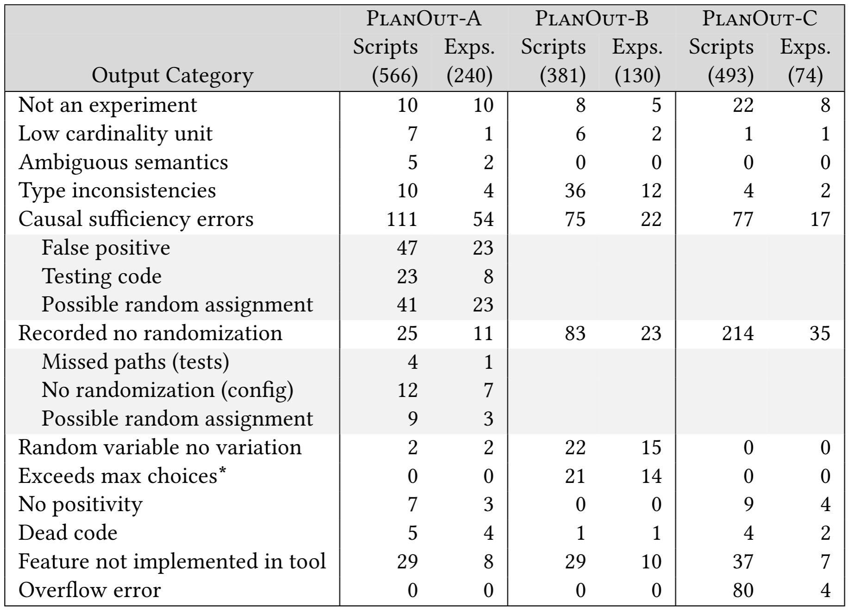
How well does PlanAlyzer do?
Notes:
So how well does PlanAlyzer do at finding threats to validity in the corpus? <CLICK> We have a complete explanation of the threats, errors, and false positives in the paper, but the high level view is

Slide 62
How well does PlanAlyzer do?
Corpora not useful for assessing PlanAlyzer on threats
Most common errors:
Mixing in testing code
Using PlanOut not as intended
…Not surprising
Notes:
The corpora aren’t really useful for assessing PlanAlyzer on threats, since <CLICK> the most common errors are <CLICK> mixing testing code, where for example a particular use or group of users are deterministically assigned treatments, and <CLICK> using PlanOut for purposes other than experimentation. <CLICK> That said, this isn’t really surprising, since we expect most PlanOut users are FB are experts in experimental design, or have access to someone who has expertise in experimental design.

Slide 63
How well does PlanAlyzer do?
Identification of threats on the mutated corpus
Notes:
So, since the corpora aren’t great for identifying threats, we will instead mutate some scripts in order to tax the PlanAlyzer tool.

Slide 64
How well does PlanAlyzer do?
Med/Avg lines of code across the corpus: 45/78
Med/Avg IR paths across the corpus: 4/29
8 mutation types
3 should never raise an error
5 should sometimes raise an error
Random selection of 50 scripts
Mutate scripts
Sample PlanOut AST point
Sample from eligible mutations
Run PlanAlyzer
Manually verify output
Notes:
First let’s consider some features of corpus A: <CLICK> our median and average lines of code are quite a bit longer than the examples we’ve been looking at. <CLICK> The number of paths in the intermediate representation is a good proxy for the number of branches in the original program. <CLICK> We defined 8 mutations types, 5 of which raise errors based on context. <CLICK> We then randomly selected 50 scripts and <CLICK> mutated them proportional to the frequency of the AST point. Finally, <CLICK> we ran PlanAlyzer on these 50 scripts and manually verified the output.

Slide 65
How well does PlanAlyzer do?
Med/Avg lines of code across the corpus: 45/78
Med/Avg IR paths across the corpus: 4/29
8 mutation types
3 should never raise an error
5 should sometimes raise an error
Random selection of 50 scripts
Mutate scripts
Sample PlanOut AST point
Sample from eligible mutations
Run PlanAlyzer
Manually verify output
Precision: 92%
Recall: 92%
Notes:
The precision and recall of this mutation was quite high, indicating that PlanAlyzer works as intended.

Slide 66
How well does PlanAlyzer do?
Correct identification of contrasts
Notes:
So finally, we need to evaluate how well PlanAlyzer does on the correct identification of contrasts.

Slide 67
How well does PlanAlyzer do?
95 experiments matched to gold-standard contrasts
Manually verified output:
Equivalent contrasts for 82% (78)
Remaining 17:
14 involved marginalization (acceptable)
3 had unparsable gold-standard contrasts
Notes:
We had 95 experiments from corpus A that had gold-standard contrasts. <CLICK> We manually verified the output, finding <CLICK> equivalent contrasts for 78 scripts. <CLICK> The remaining 17 had contrasts that are currently outside the scope of our tool.

Slide 68
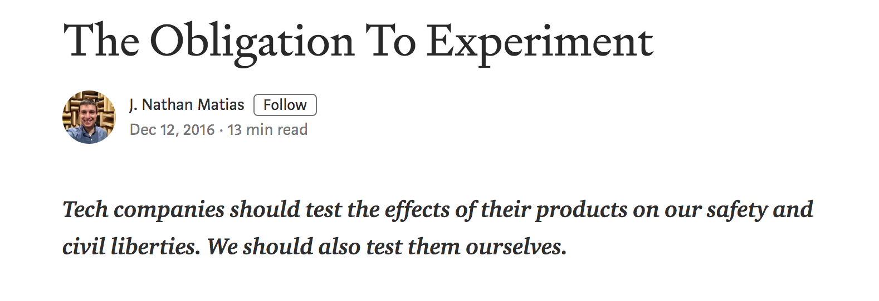

Concluding remarks
Does work in this area pose an existential threat to civil liberties?
Notes:
Now, <EXHALE> I am not an employee of Facebook. I cannot speak for Facebook. I cannot defend Facebook. I know that there are very thoughtful people there. I also know that what’s been going on there is so much more complicated than how it’s generally reported.
I also agree that so much about the infrastructure of our digital institutions is broken. That said, I don’t think we should react by not experimenting at all. Instead, I personally feel strongly that in many cases, under the right conditions, experimentation is the ethical choice, <CLICK> and I encourage anyone who has concerns about experimentation to read the work of people who are far better informed about these issues than I am.

Slide 69

A Call to Action
I am graduating.
I believe this area is important and deserves the care and respect of people across many disciplines.
Given my uncertain future, continuing to work in this area may not be possible for me personally.
Notes:
So, what to do? <CLICK> Well, I am graduating. <CLICK> I also think this area is very important, but also very complicated, and doing good work in it require cooperation and listening. <CLICK> Since my future right now is very uncertain, and working in this area requires resources, isn’t clear that I will be able to continue in it. <CLICK> But many of you probably can.

Slide 70
Thank you!
My collaborators and their support over the years
Labmates over the years
Reviewers
Takeaway:
PlanAlyzer uses static program analysis to diagnose well-known threats to internal validity of programmatically defined online field experiments, and generates contrasts and conditioning sets for the subset of between-subjects experiments that can be analyzed using ATE and CATE.

Slide 71
How well does PlanAlyzer do?
Threat 1: Recording non-random treatments
e.g., single user tests are not significant
Technically incorrect.
(but these manifestations are not that interesting)

Slide 72
How well does PlanAlyzer do?
Threat 2: Not recording values conditioned on
Technically incorrect.
(but these manifestations are not that interesting)

Slide 73
How well does PlanAlyzer do?
Threat 2: Not recording values conditioned on
Limitations of the open-world assumption, conservative analysis

Slide 74
How well does PlanAlyzer do?
Threat 2: Not recording values conditioned on
Lack of information from FB

Slide 75
How well does PlanAlyzer do?
Threat 3: Turning off randomization

Slide 76

PlanOut programs are software
PlanOut is a language and framework
Language features (typical):
Control flow
Variable declaration
Conditional branching
Language features (atypical):
Randomized assignment
Open world assumption
”Logging” (data-recording)
Language restrictions (typical):
No loops or recursion
No new function or type definitions

Slide 77
Non-A/B tests
Within-subjects
Comparing measurements for the same person on different days
Comparing measurements for the same person on different devices
Varying treatment on the basis of aggregate response (e.g., contextual bandits experiments)
Varying treatment on the basis of individual response (e.g., time-series)

Slide 78
Where to go from here?
Expertise in
Experimental Design
Expertise in Programming

Slide 79
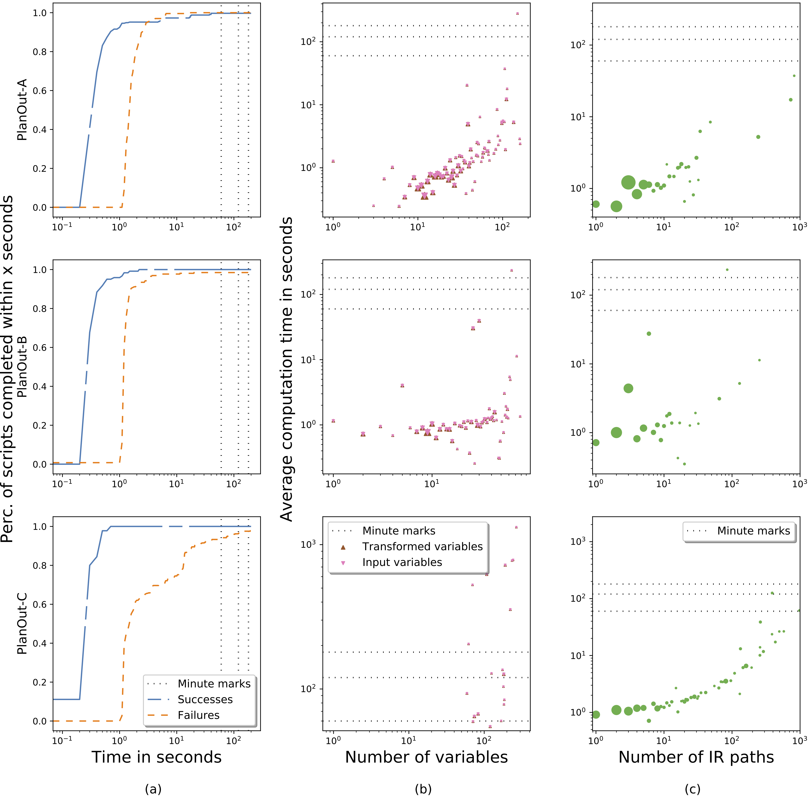
Performance
IR paths
(proxy for branching factor)
a decent predictor for time to complete analysis.
Vast majority of real scripts don’t have performance issues.

Slide 80
Variable Labels
rand<unit list> – whether a variable is randomly assigned, tracks units of randomization.
dyn – whether a variable is expected to change its value over the course of an experiment
card – high/low cardinality. Determined by user input and heuristics
corry – whether we expect a variable to be correlated with Y. Determined by user input and heuristics.

Slide 81
Threats to the Validity of the Evaluation
Other firms: Glassdoor, Nordstrom, Hubspot
Verification of Contrasts: Eytan
Verification of Errors (original corpus + mutation testing): Emma
Mutations based on syntactically valid PlanOut programs that

